Slide 1
SKILL AND JOB RECOMENDER
INDUSTRY MENTOR NAME: KRISHNA CHAITANYA
FACULTY MENTOR NAME: ABIRAMI.K
EVALUATOR NAME: DR.J.SATHYAPRIYA
PEPIN PERSIA(113219071030)
YOGESHWARI. S (113219071047)
BHOOMIHA.M (113219071003)
SUBASREE.S(113219071042)
Team Members:

Slide 2
ABSTRACT
In the last years, job recommender system have become popular since they successfully reduce information overload by generating personalized job suggestions. Although in the literature exists a variety of techniques and strategies used as part of job recommender system, most of them fail to recommending job vacancies that fit properly to the job seekers profiles. Thus, the contributions of this work are threefold, we: i) made publicly available a new data set formed by a set of job seekers profiles and a set of job vacancies collected from different job search engine sites; ii) put forward the proposal of a framework for job recommendation based on professional skills of job seekers; and iii) carried out an evaluation to quantify empirically the recommendation abilities of two state-of-the-art methods, considering different configurations, within the proposed framework. We thus present a general panorama of job recommendation task aiming to facilitate research and real-world application design using Cloud Application.

Slide 3
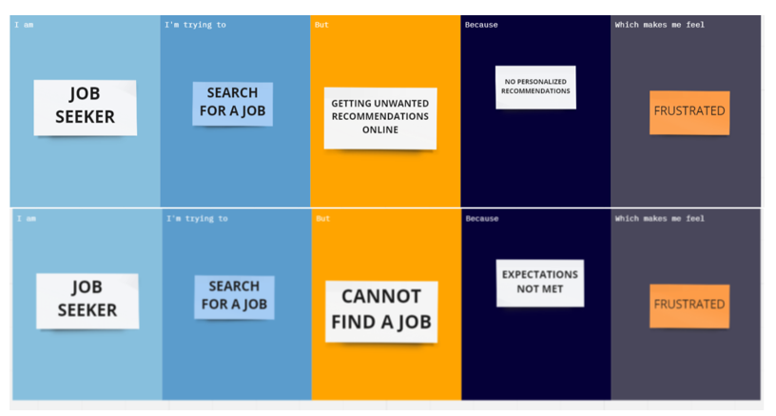
PROBLEM STATEMENT

Slide 4
PREPARATION PHASE
Assignments:
https://github.com/IBM-EPBL/IBM-Project-23247-1659874241/tree/main/Assignment

Slide 5
IDEATION PHASE
Brainstorming-idea generation-prioritization template :
https://github.com/IBM-EPBL/IBM-Project-23247-1659874241/blob/main/Project%20Design%20and%20Planning/Ideation%20Phase/Brainstorming.pdf
Problem statement template :
https://github.com/IBM-EPBL/IBM-Project-23247-1659874241/blob/main/Project%20Design%20and%20Planning/Ideation%20Phase/PROBLEM%20STATEMENT.docx

Slide 6
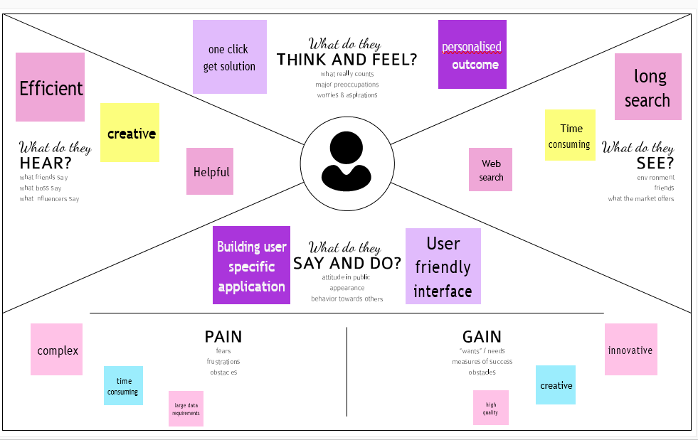
Empathy map canvas:

Slide 7
PROJECT DESIGN PHASE-I
Proposed solution :
https://github.com/IBM-EPBL/IBM-Project-23247-1659874241/blob/main/Project%20Design%20and%20Planning/Project%20Design%20Phase%201/Proposed%20Solution%20.pdf
Solution Architecture:
https://github.com/IBM-EPBL/IBM-Project-23247-1659874241/blob/main/Project%20Design%20and%20Planning/Project%20Design%20Phase%201/Solution%20Architecture.pdf
Problem solution fit :
https://github.com/IBM-EPBL/IBM-Project-23247-1659874241/blob/main/Project%20Design%20and%20Planning/Project%20Design%20Phase%201/Problem_solution_fit%20.pdf

Slide 8
PROJECT IDEATION PHASE-II
Customer journey map:
https://github.com/IBM-EPBL/IBM-Project-23247-1659874241/blob/main/Project%20Design%20and%20Planning/Project%20design%20Phase%202/Customer%20Journey%20Mapp.pdf
Data flow diagrams and user stories :
https://github.com/IBM-EPBL/IBM-Project-23247-1659874241/blob/main/Project%20Design%20and%20Planning/Project%20design%20Phase%202/Data%20Flow%20Diagrams%20and%20User%20Stories.pdf
Functional requirements :
https://github.com/IBM-EPBL/IBM-Project-23247-1659874241/blob/main/Project%20Design%20and%20Planning/Project%20design%20Phase%202/Solution%20Requirements.docx
Technology architecture and technology stack :
https://github.com/IBM-EPBL/IBM-Project-23247-1659874241/blob/main/Project%20Design%20and%20Planning/Project%20design%20Phase%202/Technology%20Stack.pdf

Slide 9
PROJECT DEVELOPMENT PHASE
Sprint 1:
https://github.com/IBM-EPBL/IBM-Project-23247-1659874241/tree/main/Assigned%20Tasks/Project%20Development%20Phase/Sprint%201
Sprint 2:
https://github.com/IBM-EPBL/IBM-Project-23247-1659874241/tree/main/Assigned%20Tasks/Project%20Development%20Phase/Sprint%202
Sprint 3:
https://github.com/IBM-EPBL/IBM-Project-23247-1659874241/tree/main/Assigned%20Tasks/Project%20Development%20Phase/Sprint%203
Sprint 4:
https://github.com/IBM-EPBL/IBM-Project-23247-1659874241/tree/main/Assigned%20Tasks/Project%20Development%20Phase/Sprint%204

Slide 10
PROJECT PLANNING
Milestone and activity list:
https://github.com/IBM-EPBL/IBM-Project-23247-1659874241/blob/main/Assigned%20Tasks/Project%20Planning%20Phase/Milestone%20and%20activity%20list%20(1).pdf
Sprint delivery plan:
https://github.com/IBM-EPBL/IBM-Project-23247-1659874241/blob/main/Assigned%20Tasks/Project%20Planning%20Phase/Sprint%20Delivery%20Plan.pdf

Slide 11
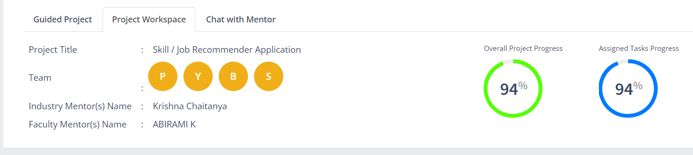
WORK PROGRESS TILL NOW

Slide 12
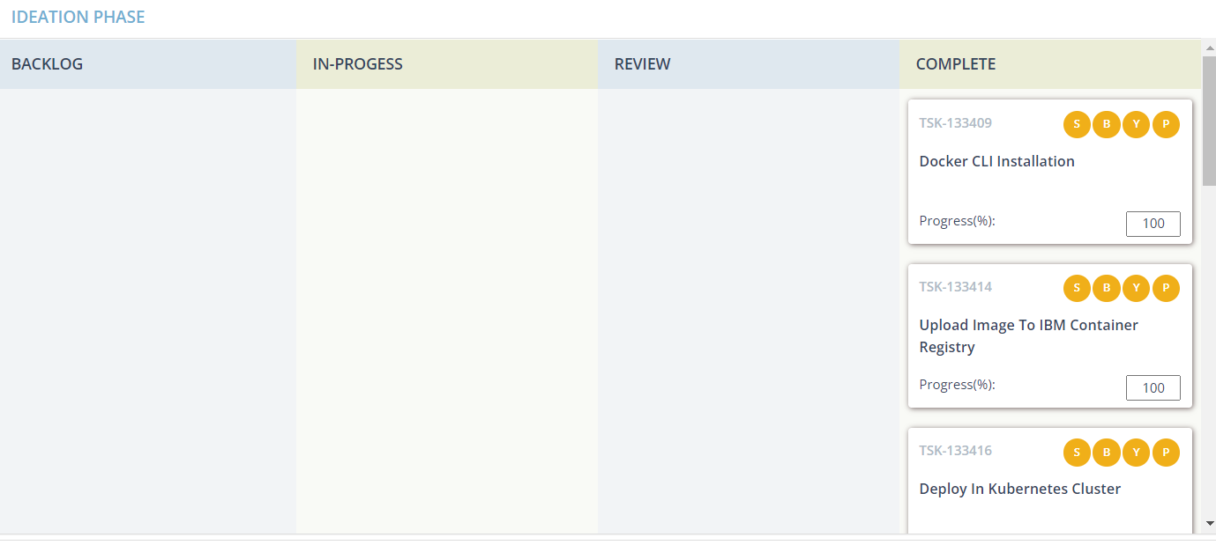
CONT…

Slide 13
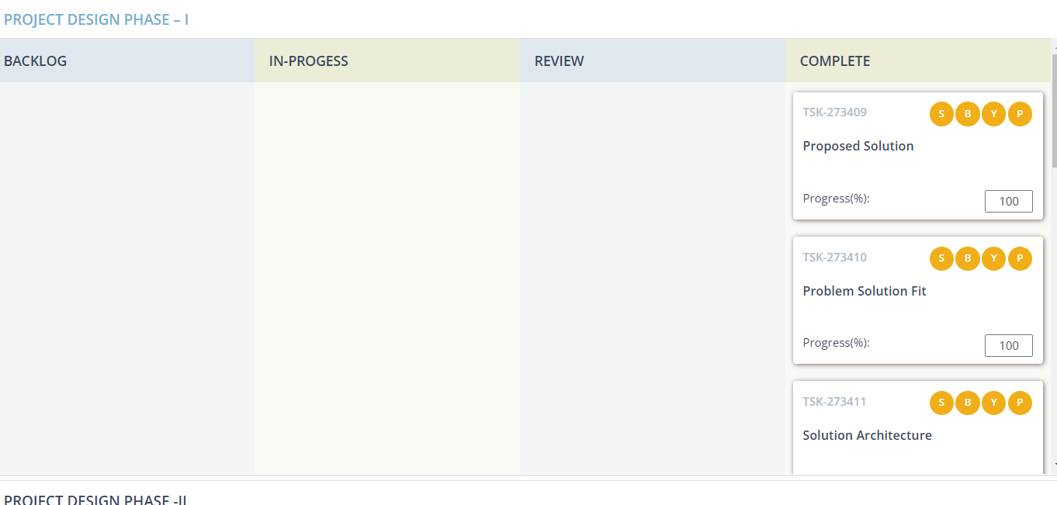

Slide 14
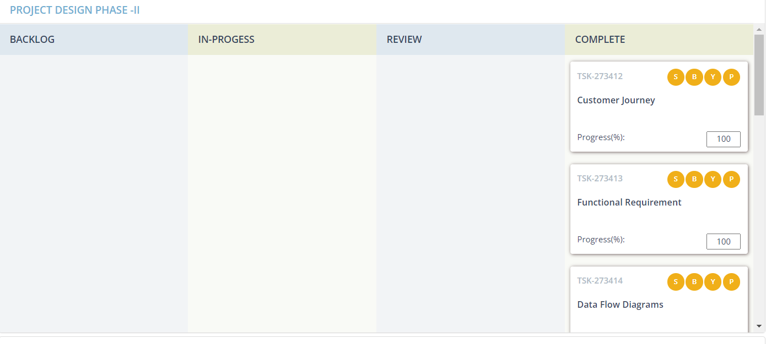

Slide 15
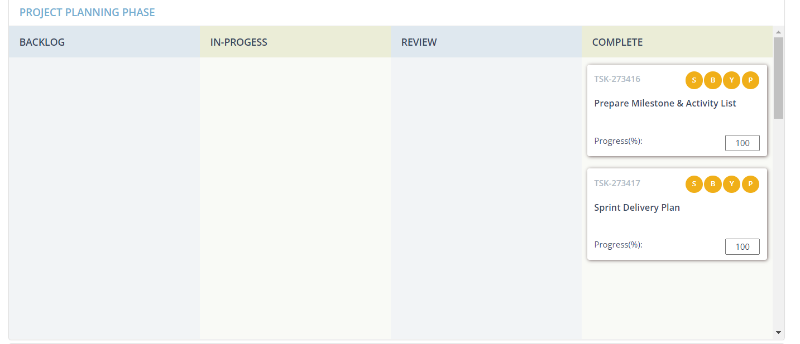

Slide 16
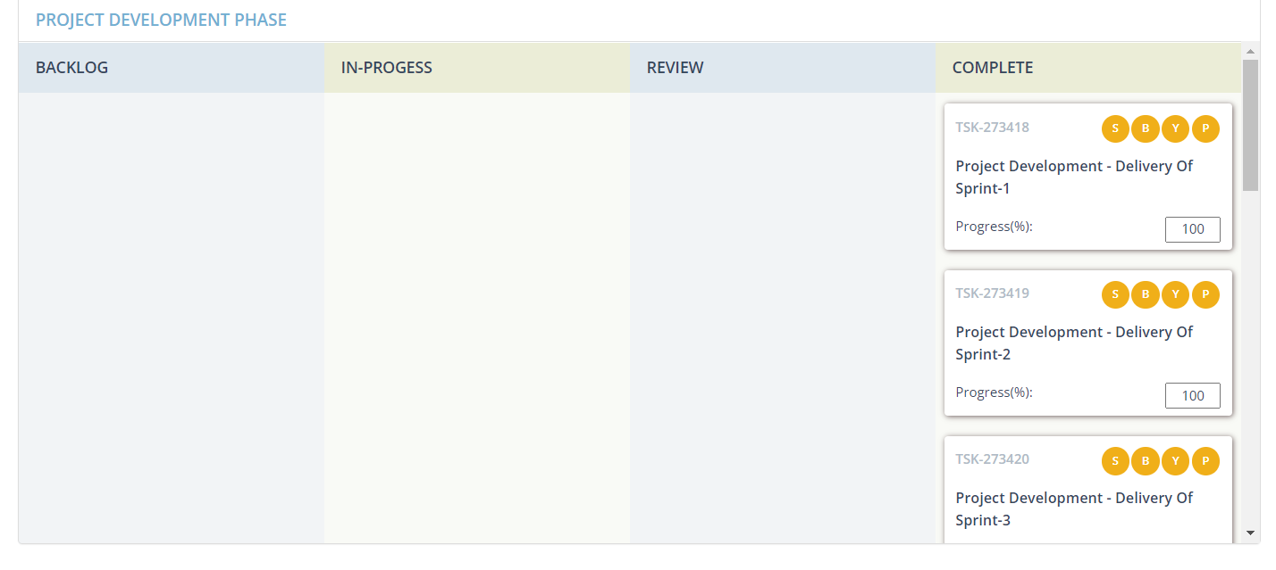

Slide 17
THANK YOU

